Slide 1
Project title : Customized Ai Kitchen for India
Developed by : VAISHVIK SHARMA

Slide 2
Idea behind the project work :
This project is about Indian Cuisine here i have 255 famous indian dishes. When user will click on any dish they will get a recipe and recommendation for that particular dish. Here i have used youtube videos for cuisine recipe and i have build a machine learning model using cosine similarity for recommendation

Slide 3
Features Offered :
Users can choose the dishes out of a wide variety of Indian veg. and non-veg. dishes and could get the youtube video for the recipe of the same
Alongwhile , the users also get recommendations based upon their respective choice and this feature is implemented using the cosine similarity technique .
Users can select dishes based upon both ‘State-wise’ and ‘Region-wise’.
The users have the access to search box for figuring out the recipes for the dishes of their own choice.

Slide 4
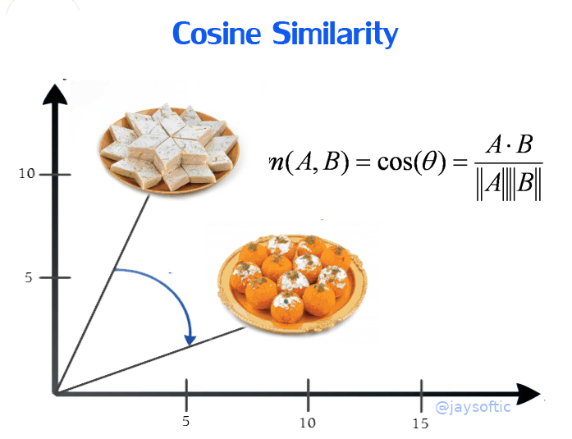
Process flow :-
In this project i have used indian food data set from kaggle you can get it from here
I have analyzed the data set and make it in shape that it help me to build a recommendation model
Here i have used Cosine Similarity to build a recommendation model.
Cosine similarity is nothing but a degree between two data points or two similar type of data
I made web app using flask, javascript, bootstrap, css and HTML you can find all the files inside this Repository
Here i have used bing_image_downloader to scrape and download all dishes images
Here i have used youtubesearchpython to get unique id of recipe vidoes from youtube which i have demonstrated at front end side as embedded video of recipe.

Slide 5








Technologies Used :

